Slide 1
Stereolithography (SLA).
Acronyms; Optical fabrication, Resin printing, photo solidification.

Slide 2
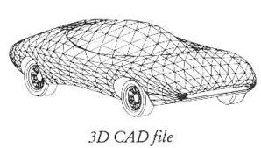
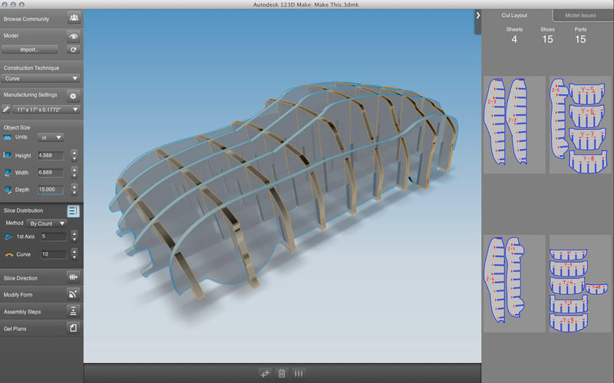
Process
At first a 3D CAD file is created
The file is digitally sliced into a series of parallel horizontal cross-sections which are then provided to a StereoLithography Apparatus (SLA) one at a time.

Slide 3
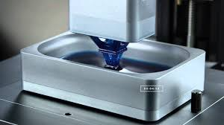
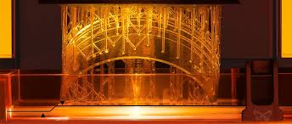
A laser traces the cross-section onto a bath of photopolymer plastic which solidifies the cross-section. The part is lowered a layer thickness into the bath and additional plastic is swept onto the surface (typically about 0.1 mm) .
The laser then solidifies the next cross-section. This process is repeated until the part is complete. Once the model is complete, the platform rises out of the vat and the excess resin is drained. The model is then removed from the platform, washed of excess resin, and then placed in a UV oven for a final curing

Slide 4
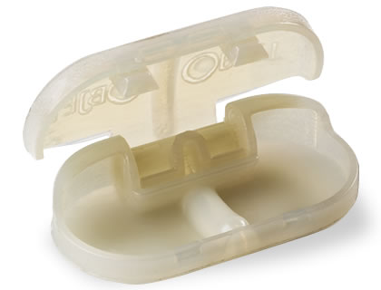
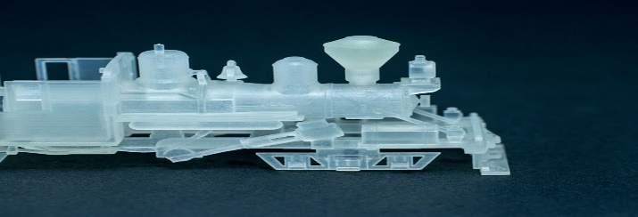
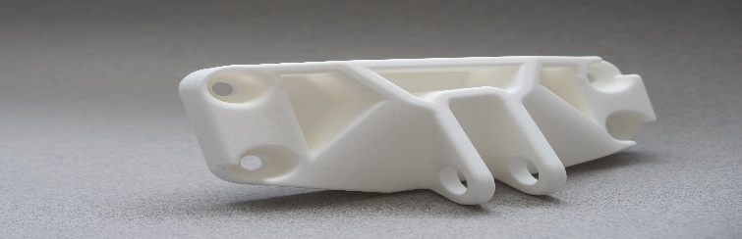
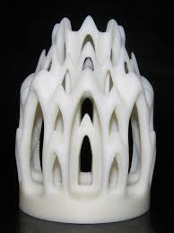
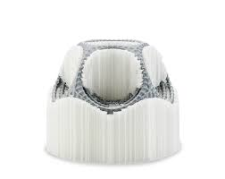
Build Materials.
Matrix materials -(Plastic materials).
Reinforcing Materials –(Plastic materials)
Polypropylene
Acrylate polymers
Nylon
Polystyrene high impact
Acrylate polymers

Slide 5
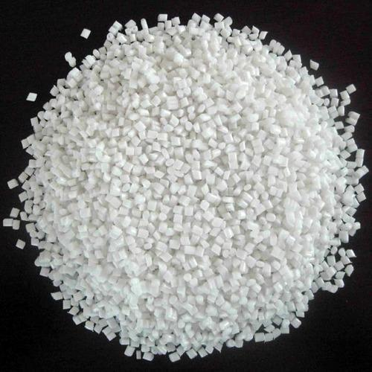

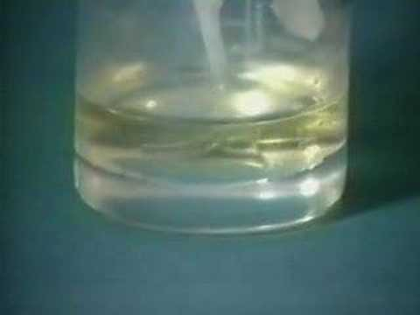
Raw Shape/Form.
Polypropylene; It is granular and sensitive to light. Melts to form a bath of about 0.1mm and additional layer is added.
Acrolyte polymers; It is liquid and sensitive to light. It forms a bath of about 0.1mm and additional layer is added.
Nylon; When loaded into machine is liquid and sensitive to light. It form aa bath of about 0.1mm and additional layer is added. I comes in color options as white or black and different mixes of the two colors.

Slide 6
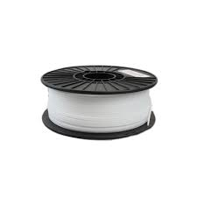
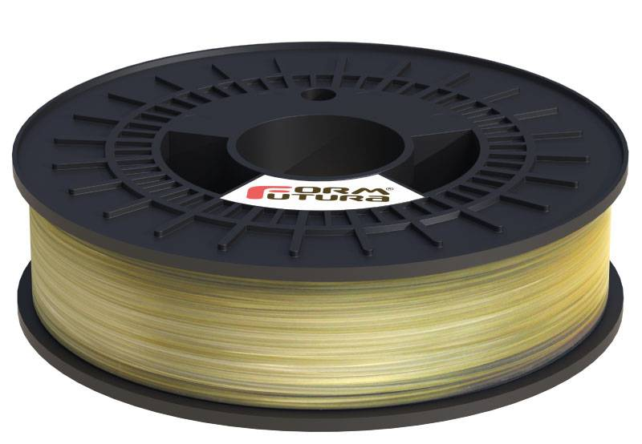
Raw Shape/Form
Polystyrene high impact; solid and sensitive to light. It is in form of a filament that is sensitive to light and is soluble.
Polyvinyl Alcohol; is solid and sensitive to light. It is in form of a filament that is sensitive to light and is soluble.

Slide 7
Work zone atamosphre
Stereolithography works in a normal atmospheric zone.
To prevent oxidation of metals due to the heat pf the laser beam shielding gases that are inert, such as argon and helium, are used.
In our case hover, shielding gases are not necessary because the material used is plastic.

Slide 8
Source of energy
Laser beams are used in Stereolithography to melt the metrix material.
low-power laser is used to harden photosensitive resin and achieve polymerization.
Spatial coherence focuses the laser on a tight spot form different sources of light.

Slide 9
Dimensional tolerance
First inch; +/- 0.005” or 0.127 mm
Second inch; +/- 0.007”
Third Inch; +/- 0.009”
Additional 0.002” for each additional inch.

Slide 10
Building speeds for each method
Technology | 3D Printer Model | Building Speeds
SLS | EOS P396 | Up to 48 mm/h
SLA | Projet 1200 | Up to 14 mm/h
DMLS | EOSINT 280 | 2 to 8 mm3/s
FDM |  | 50 to 150 mm/h

Slide 11
Building speed
Plastic | Maximum
 | 677 x 368 x 565 $/mm
Silver/Brass | Maximum
 | 60 x 80 x 100 $/mm
Resin | Maximum
 | 290 x 190 x 147 $/mm
Alumide | Maximum
 | 300 x 300 x 500 $/mm

Slide 12
Building costs
SLS | Maximum
 | 15 $/mm
SLA
 | 10 $/mm
FDM
 | 7 $/mm

Slide 13
DRAWBACKS
 | Fused Deposition Modeling (FDM) | Stereolithography (SLA) | Selective Laser Sintering (SLS)
Cons | Low accuracy Low details Limited design compatibility | Limited build volume on desktop | Rough surface finish Limited material options

Slide 14
References
Bártolo, P. J. (Ed.). (2011). Stereolithography: materials, processes and applications. Springer Science & Business Media.
Joe Lopes, A., MacDonald, E., & Wicker, R. B. (2012). Integrating stereolithography and direct print technologies for 3D structural electronics fabrication. Rapid Prototyping Journal, 18(2), 129-143.
Melchels, F. P., Feijen, J., & Grijpma, D. W. (2010). A review on stereolithography and its applications in biomedical engineering. Biomaterials, 31(24), 6121-6130.

Slide 15
https://www.google.com/search?biw=1242&bih=557&tbm=isch&sa=1&ei=Pp59Wo69AdD3zgLyv46IBw&q=polyvinyl+alcohol+soluble+Pritning&oq=polyvinyl+alcohol+soluble+Pritning&gs_l=psy-ab.3...2964.5594.0.6000.9.7.0.0.0.0.354.679.3-2.2.0....0...1c.1.64.psy-ab..7.1.351...0i24k1.0._xywlS_yAPo#imgrc=KIhBPlALktSqaM
https://www.google.com/search?q=high+impact+polystyrene+filament&source=lnms&tbm=isch&sa=X&ved=0ahUKEwjuus3r9pjZAhUC3o8KHbnwCnwQ_AUICigB&biw=1242&bih=557#imgrc=qI0EaIR2pXmM6M:
https://www.google.com/search?q=design+for+car+by+auto+cad&sa=X&hl=en-KE&tbm=isch&tbo=u&source=univ&ved=0ahUKEwjWleTB-ZjZAhXIMY8KHWRlBwsQsAQIJg&biw=1242&bih=557#imgrc=2fTqNihdv5ClDM:
https://www.google.com/search?q=123d+make&hl=en-KE&source=lnms&tbm=isch&sa=X&ved=0ahUKEwibtLni-ZjZAhUGr48KHYf_B2YQ_AUICigB&biw=1242&bih=557#imgrc=iCZzYqOLB2NerM:

